Slide 1
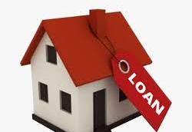
Home Loan Application
Low Level Design (LLD)
Date: 05/12/2022
Current Document Version: [1.0]

Slide 2
DOCUMENT APPROVAL
Approvers of this document
Name | Department | Role | Signature | Date
DOCUMENT CHANGE HISTORY
Document Version# | Author | Date | Description
1.0 |  | 05 /12/2022

Slide 3
Table of Contents
1.0 Document Purpose ........................................................................................... 1
2.0 Intended Audience ........................................................................................... 1
3.0 Project Background, Objective(s) ...................................................................... 1
3.1 Project Background ...........................................................................................1
3.2 Project Objective ...............................................................................................1
4.0 Design Pattern .................................................................................................. 4
4.1 Solution Diagram .............................................................................................. 4
4.2 Function of Diagram .......................................................................................... 4
6.0 UML Diagram .....................................................................................................8
6.1 Use case Diagram ...............................................................................................8
6.2 Sequence Diagram.............................................................................................. 9
6.3 Activity Diagram………………………………………………………………………………………………….10

Slide 4
1.0 Document Purpose
This document describes the solution architecture for Home Loan application. Applying for home loan is a hectic and long process . Hence we have created online home loan application which will make the loan process easy and user friendly.
2.0 Intended Audience
This document is intended as a reference for the following roles and stakeholders who are interested in the Home Loan Application technical architecture. The people who wants to apply for home loan are always welcome to our home loan application.
Role
Product Owners/SME
Business Analysts
Enterprise Architects
Solution Architects
Developers

Slide 5
3.0 Project Background, Objective(s)
3.1 Project Background
Home Loan Application leads to perform management of loan appliers details where one can register themselves and apply for home loan efficiently. I t makes the hectic loan process efficient.
3.2 Project Objective
Home Loan Application will perform various operations like listing, creation, updating and deletion of Customer Details. These operations can be done by authorized persons.
Customers can first register themselves and then they can apply for loan.

Slide 6
Problems
The processing takes more than 10-12 days depending on the profile of the customer and the documents submitted
Requires individual to visit the financial institution and fill out necessary forms
Risk of losing crucial paperwork is higher
Solution
The processing happens in the next hours and involves instant approvals
Can be done from anywhere and at the click of a button
Completely secure process

Slide 7
4.0
Design Pattern | Name | Description
1 | API | Using HTTP requests, we will use the respective action to trigger various operations
2 | Frontend | Angular
3 | Database | SSMS

Slide 8
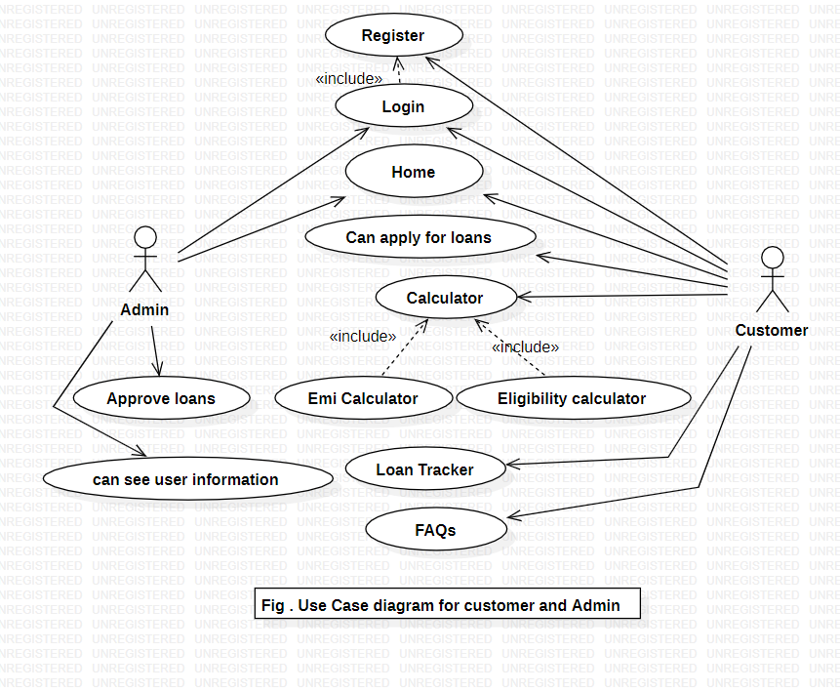
Use case Diagram

Slide 9
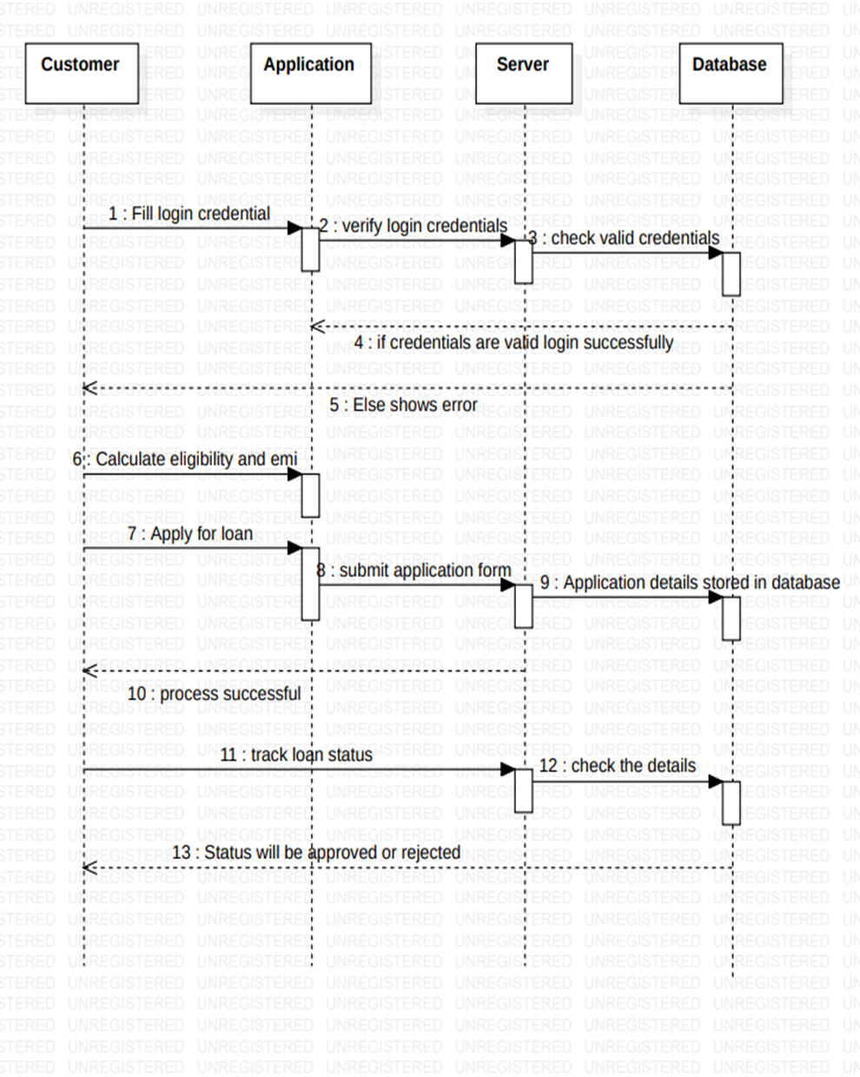
User Sequence Diagram

Slide 10
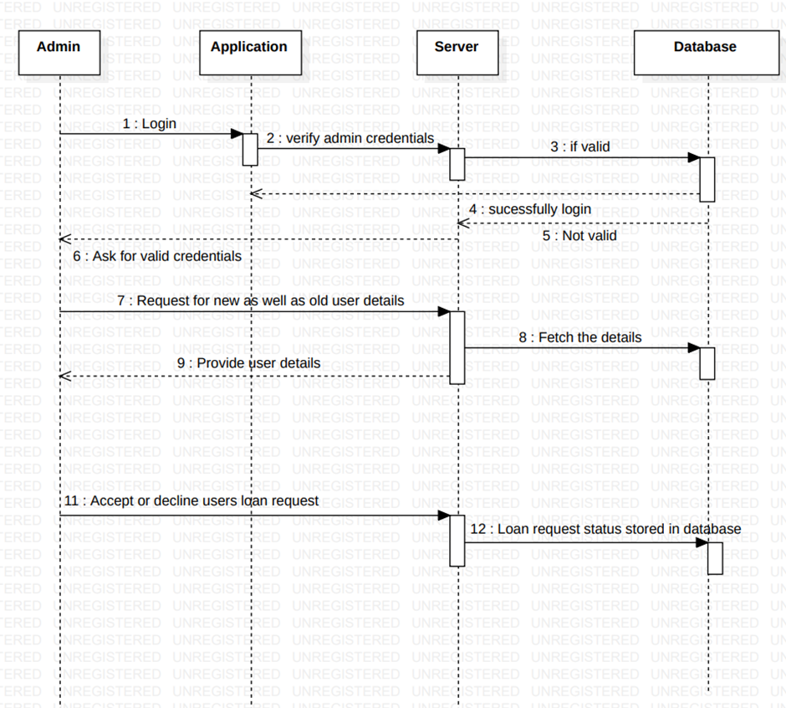
Admin Sequence Diagram

Slide 11
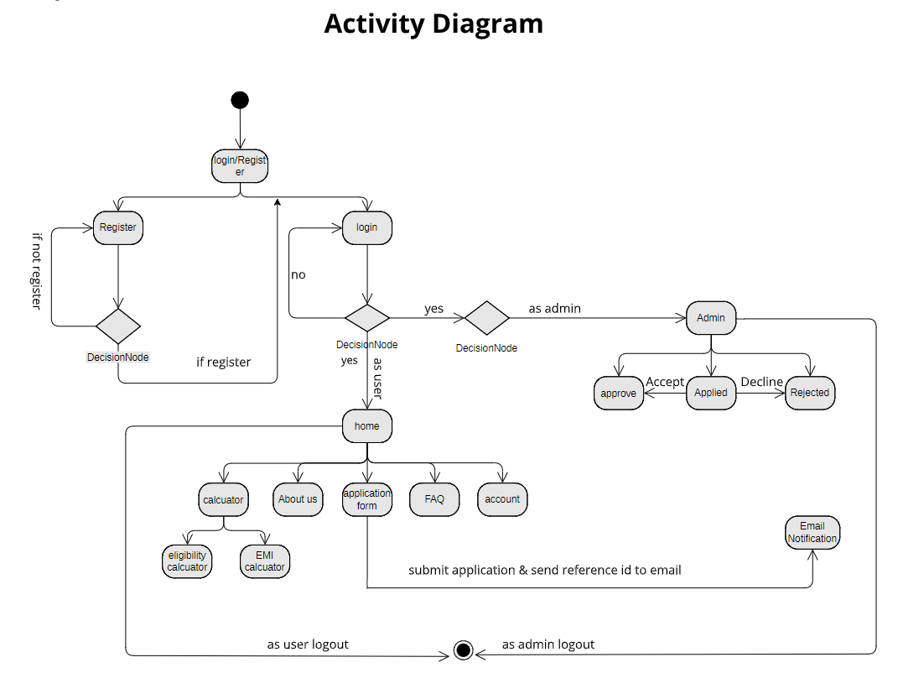

Slide 12
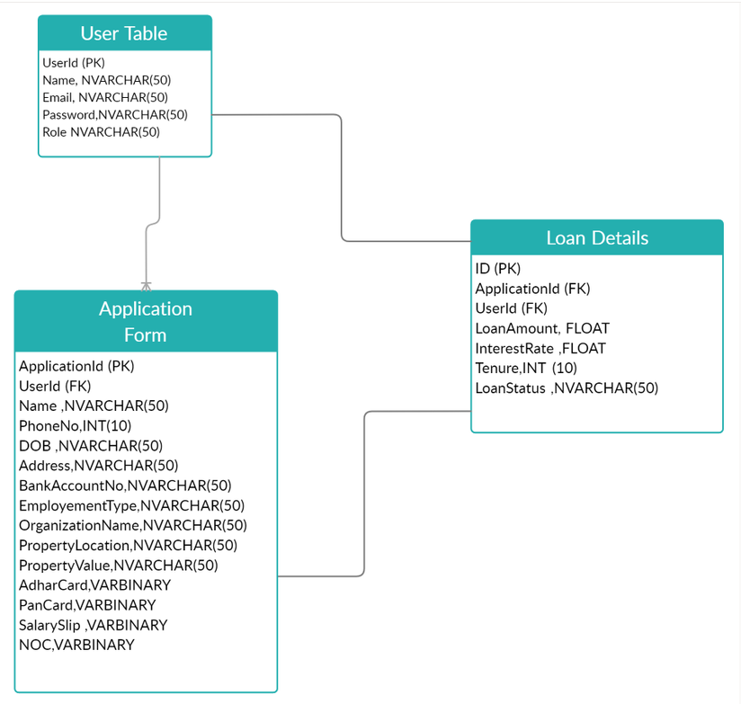
Database Diagram

